Slide 1
Final Project - The Battle of the Neighborhoods!

Slide 2
Introduction
In this challenge, I'm going to tackle the social texture of the city of Jerusalem! I'll conduct a thorough analysis which will conclude with a clustering for the various venues throughout the different neighborhoods. as a city with a unique socio-demographic texture, this analysis should be super interesting.
this problem should appeal to anyone who cares about the socio demographic texture of the city (or care to visit!)

Slide 3
Data
I'm going to utilize data from wikipedia (download and parse), grab some data from the google geocode API and in order to get the venue list - use the foursquare API.

Slide 4
Methodology
1. scrap neighborhood data using BeatutifulSoup from wiki - parse, wrangle, and clean it.
2. extract lonitude and latitude coordinates using geocoder
3. validating the base-data (manually and by visualization)
4. extracting the jerusalem long/lat for the map usage using google geocode API
5. fetching the venue lists per neighborhood
6. preparing the data for clustering (OHE per unique venue category, etc.)
7. executing clustering algo
8. visualize the results
9. summarize and discuss the results

Slide 5

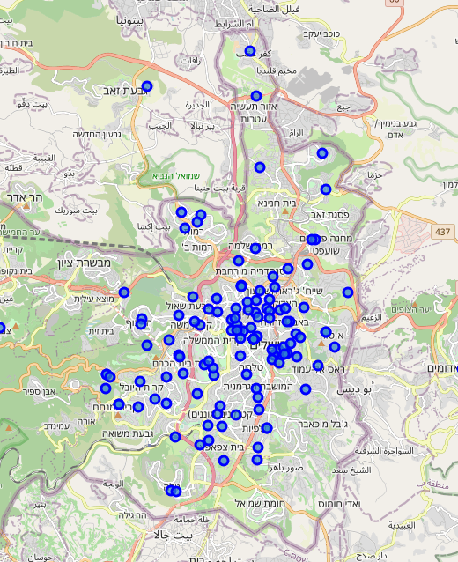
Initial Map

Slide 6
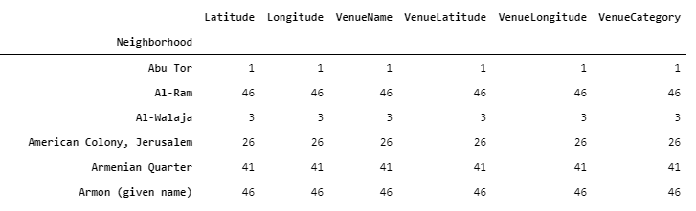
Glimpse into the data
we see that we have incomplete entreis for some of the neighborhoods
low number of results (out of a possible 14k we've received only 3k, which means there isn't too much data for Jerusalem in foursquare)

Slide 7
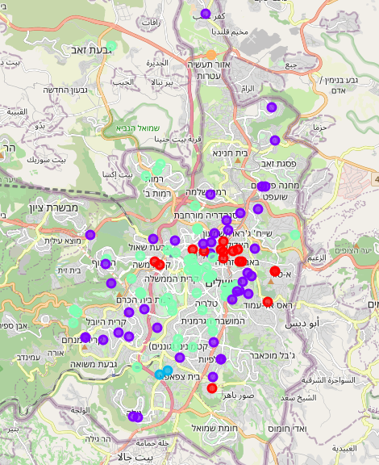
Clustering

Slide 8
Summary
Important observation - (relatively) low number of venues. A breakdown shows a significant variance of venues for neighborhoods.
An important aspect of Israel, and Jerusalem in particular is the social texture. the city is somewhat split - 1/3 are religious Jews, 1/3 are non-religious Jews and 1/3 are Arabs (roughly).
It appears that we have less information as a whole for the 2/3 of the Arab and the religious Jewish neighborhoods - which aligns with our expectations (these fractions of the population are somewhat less vanguard when it comes to technology).
analyzed the entire set of neighborhoods in order to differentiate between populations rather than conducting a within population analysis (however, perhaps for future tasks...)

Slide 9
Summary (Cont’d)
the clustering results make some sense as it appears to capture the difference between relatively mid-income non-religious Jewish neighborhoods (light green), and low income neighborhoods (purple), the Arab neighborhoods either fall in the purple (low income) neighborhoods or in red (east Jerusalem) .
when conducting this analysis, we need to consider the low number of observations for some of the neighborhoods which affect the results drastically.

